Slide 1
Multi-Dimensional Arrays
Object Oriented Development (CIS1056-N)

Slide 2
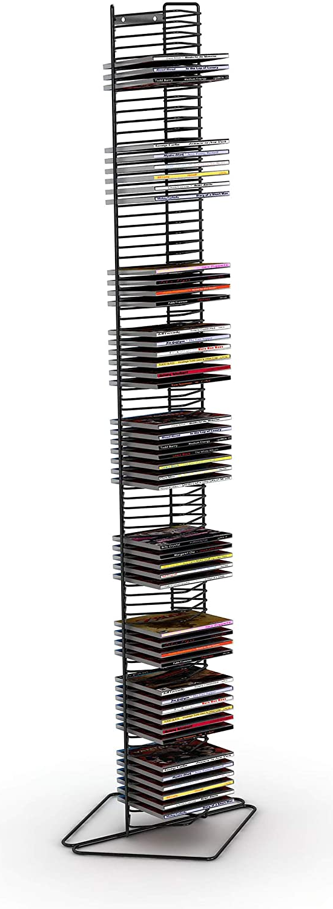
Arrays Recap
In Week 4 we introduced the idea of Java Arrays
Containers for closely related variables and objects.
Think of a CD stacking unit (with individual trays for each CD).
Arrays contain a group of data items (elements).
All elements must be of the same type (e.g. int, char, boolean, String etc… but also objects)

Slide 3
Declaring an array
int[] attendanceData = new int[12];
identifier of the array (a reference variable)
Number of elements that will be stored in the array
Type of data to be stored in the array
Call to the constructor
Square brackets indicate we are declaring an array
Link the reference variable to the array object

Slide 4
Why use collections?
You are a teacher and you have written a Java application to help you keep track of student attendance.
The number of students attending your class each week is recorded in your Java app as an int variable.
int weekOne = 54;
int weekTwo = 49;
int weekThree = 29; // Flu season
At the end of term, how do you add these figures together easily, how do you sort them?
int total = weekOne + weekTwo + weekThree // etc.

Slide 5
Variables vs. Arrays
Individual variables
Alternative (arrays)
Each individual variable needs to be declared (and given a name).
Declare once and number each location.
Memory |  | Java
 | :
weekOne | 54 | int weekOne = 54;
weekTwo | 49 | int weekTwo = 49;
weekThree | 29 | int weekThree = 29;
 | :
Memory |  | Java
 | : | int[] att = new int[12];
att 0 | 54 | att[0] = 54;
1 | 49 | att[1] = 49;
2 | 29 | att[2] = 29;
 | :
Total Algorithm
total = weekOne + weekTwo + weekThree
Total Algorithm
total = 0
for i = 0 to last week number
total = total + att element i

Slide 6
Attendance Example
Let’s imagine that the class attendance solution worked so well, the teacher wants to start applying it to other classes.
The teacher wants to use the data to compare between classes, calculate totals for the overall year, and so on.
How can we implement this?
 | Maths | English | Science
1 | 54 | 49 | 47
2 | 49 | 52 | 42
3 | 29 | 38 | 31
…
13 | 37 | 26 | 34

Slide 7
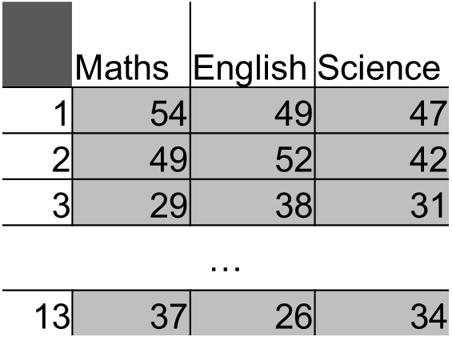
Direct Approach
An obvious solution would be to add additional Arrays for each new subject
int[] maths = new int[12];
int[] eng = new int[12];
int[] sci = new int[12];
We can then populate each array with data and calculate the needed values
Is this a good solution?

Slide 8
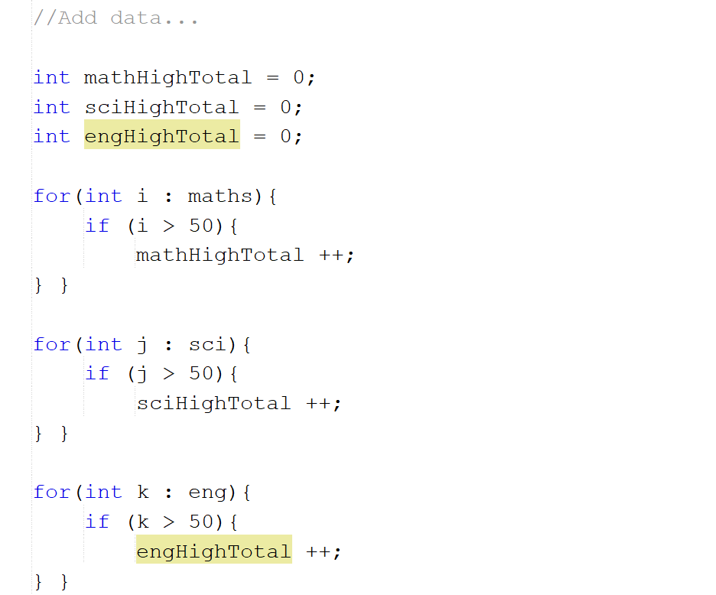
Direct Approach
No!
This approach introduces a lot of repetition: we need to duplicate our loops for each array.
Or create a method, but repetition and complexity there too.
Adding new subjects is more difficult: we need to code new arrays with each one added.
Is there a better approach?

Slide 9
Better Approach
Each of the arrays we created has a lot of similarities
Same length
Same type
… and is utilised in the same way.
Same calculations
Same loops (in this example)
How have we handled groups of data like this in the past?
“Arrays are containers for closely related variables and objects.”

Slide 10
Two-Dimensional Arrays
Recall that a Java array is an object.
This means we can create an array that stores array objects.
This is a 2-dimensional array – an array of arrays.
“Arrays are containers for closely related variables and objects.”

Slide 11
Two-Dimensional Arrays
A 2D array can be imagined as a table: a set of rows and columns.
Each index in the “first” array stores an array of values.
Each of these “secondary” arrays store values of the specified type.
The type must be the same for all arrays – you can’t mix ints and Strings, as an example.
 | 0 | 1 | 2
0 | 54 | 49 | 47
1 | 49 | 52 | 42
2 | 29 | 38 | 31
3 | 32 | 38 | 38
4 | 28 | 35 | 35
5 | 25 | 31 | 36
6 | 24 | 29 | 32
7 | 26 | 27 | 29
8 | 28 | 28 | 27
9 | 25 | 27 | 24
10 | 31 | 30 | 27
11 | 34 | 29 | 29
12 | 37 | 26 | 34

Slide 12
Int[][] attendance = new int[3][13]
identifier of the array (a reference variable)
Number of elements that will be stored in the second array
Type of data to be stored in the arrays
Call to the constructor
Double square brackets indicate we are declaring a multi-dimensional array
Link the reference variable to the array object
Number of elements that will be stored in the first array

Slide 13
Populating 2D Arrays
Using 2D arrays is similar to normal array accesses – supply an index to access the data stored there.
The key difference is that you must supply 2 indexes: one to specify which array to access and one to specify the location to use.
int[][] timesTables =
new int[10][10]
timesTables[0][0] = 1;
timesTables[0][1] = 2;
//...
timesTables[9][9] = 100;

Slide 14
Using Elements
As with normal arrays, 2D arrays can be used as arguments or values in other code: Format arrayName[arrayNum][elementNum]
System.out.println(attendanceData[0][1]);
int a = attendanceData[4][2] + 4;
if (attendance[2][3] > 50) { ... }

Slide 15
Setting Values
You can use the literal definition approach for 2D Arrays
This approach helps illustrate the array-of-arrays structure: each “value” in the timesTable array is another array.
int[][] timesTables = {
{1,2,3,4,5}, {2,4,6,8,10},
{3,6,9,12,15}
};

Slide 16
2D Arrays
You can set values on a index-by-index basis if needed.
Useful for updating specific values, but a lot of repetition for a known result…
timesTables[0][0] = 1;
timesTables[0][0] = 2;
timesTables[0][0] = 3;
…
timesTables[9][9] = 100;

Slide 17
2D Arrays and Loops
As with 1-dimensional arrays, for-loops are an effective way to manage and access 2D arrays.
But how do we use them?
How would you write a loop to access every location in a 2D array?

Slide 18
2D Arrays and Loops
As each element of a 2D array is an array, we will need to use 2 for-loops.
One to select the array
One to select the value
The inner for-loop will iterate over each array
While the outer for-loop updates the array targeted by the inner loop
for(int i = 0; i < ??; i++){
for(int j = 0; j< ??; j++){
timesTables[i][j] = i*j;
} }

Slide 19
2D Arrays and Loops
But what values do we use as the limits?
IndexOutOfBoundsExceptions are still a valid concern.
timesTables.length = number of arrays
timesTables[n].length = length of array n
for(int i = 0; i < ??; i++){
for(int j = 0; j< ??; j++){
timesTables[i][j] = i*j;
} }

Slide 20
Metalli (Again)
A different bit this time

Slide 21
Summary
Arrays can be defined as multi-dimensional: an array of arrays
These arrays must be of the same type, but can store multiple groupings of closely related data
Use nested loops to iterate over every value.
Usual advantages and limitations apply!

Slide 22
Any Questions?

